Slide 1
Understanding How Frontend (FE) and Backend (BE) Work Together
Using async / await
Why two await?
await fetch(...) Waits for the server to respond
await response.json() Waits for converting data into JSON format
Both steps take time, so both must be awaited.

Slide 2
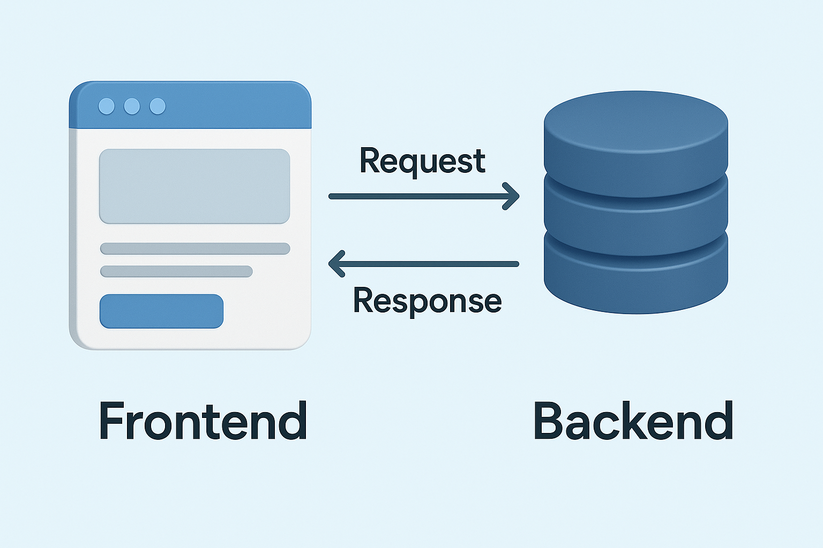
Understanding How Frontend (FE) and Backend (BE) Work Together

Slide 3
FIREBASE
Firebase is a platform by Google that helps you create mobile apps and websites quickly without worrying about servers, databases, or complex backend code.
In simple terms:
Firebase = Ready-made tools + Cloud services that help you build apps faster
Just like you use Zomato instead of cooking food yourself, developers use Firebase instead of creating everything from scratch.
Firebase = Ready-made backend for your app

Slide 4
Firebase
It gives tools that solve common app problems like:
User login
Saving data
Sending notifications
Storing images
Tracking user activities

Slide 5
FIREBASE
Why Do Developers Use Firebase?
Without Firebase, a developer must:
Buy a server
Manage a database
Write code to send notifications
Create login systems
Analyze users
Firebase gives all these features already built — just plug and use!
Firebase is a Backend-as-a-Service (BaaS) platform by Google that provides cloud-based services

Slide 6
FIREBASE
Why Do We Need Firebase?
Traditionally, if you create an app, you need:
Task | Without Firebase | With Firebase
Server setup | Buy & manage servers | No server needed
Database | Install & maintain | Built-in database
Login system | Write complex code | Ready authentication
Notifications | Build own system | One-click messaging
Analytics | Integrate tools | Built-in analytics
Firebase literally removes 50–70% of backend work.

Slide 7
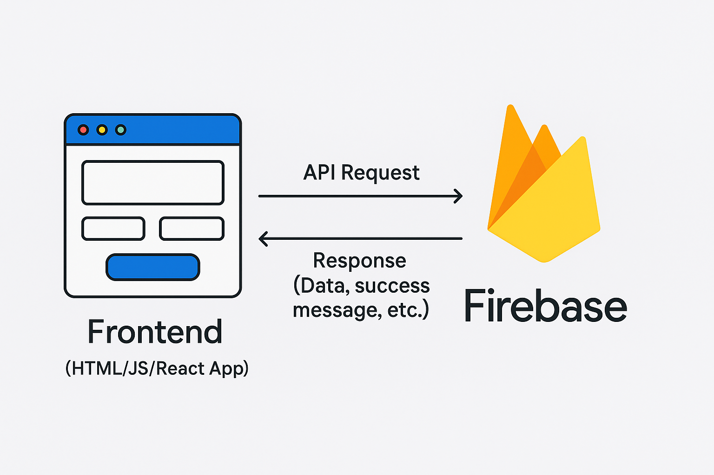
FIREBASE

Slide 8
FIREBASE
Firebase Architecture in Simple Terms
Think of Firebase as a store where you pick services you need.
Here are the main blocks:
Firebase Authentication
Purpose: Helps users sign in securely.
Supports login using:
Email and password
Phone OTP
Google
Facebook
Apple ID
Example When Instagram lets you "Continue with Google" — Firebase can handle that.

Slide 9
FIREBASE
2. Firestore / Realtime Database
Firebase provides two databases:
Feature | Realtime DB | Firestore
Updates | Instant | Fast & scalable
Structure | JSON tree | Collections & documents
Best for | Chat apps | Modern apps
Example WhatsApp messages appearing instantly — this is like Firebase Realtime Database.

Slide 10
FIREBASE
3. Firebase Storage
Used to store files like:
Photos
Videos
PDFs
Example
Uploading profile pictures in apps like LinkedIn.
4. Firebase Cloud Messaging (FCM)
Used to send push notifications
“Order Shipped”
“Your friend sent a message”
"New video uploaded!“
Apps don’t have to build this from scratch.

Slide 11
FIREBASE
5. Firebase Analytics
Tracks user behavior:
Who installed your app?
Which screen users open most?
Why users uninstall?
Example
YouTube suggests videos based on your behavior — that’s analytics.
Firebase Hosting
Firebase can publish websites directly:
Upload and go live in seconds
Super-fast performance
Ideal for:
Portfolio websites
Student projects
Single Page Apps

Slide 12
FIREBASE

Slide 13
FIREBASE
Frontend (App UI)
This is what the user sees
Backend (Firebase)
This is where data, login, notifications, storage happen
Frontend (HTML/JS/React App)
|
| API Request
↓
Firebase Backend
|
| Response (Data, success message, etc.)
↓
Frontend Updates on Screen

Slide 14
FIREBASE
User types name in a form
Clicks Save → Sends request to Firebase Database
Firebase stores it
Firebase responds → “Data Saved Successfully”
App shows success message

Slide 15
FIREBASE
Where Is Firebase Used?
Used by:
Startups
Students building projects
Social media apps
E-commerce apps
Real-time chat apps
Games and IoT
Companies like Spotify, Lyft, Alibaba, and Accenture also use Firebase.

Slide 16
FIREBASE
Is Firebase a Database or a Platform?
It is a platform that includes a database, storage, analytics, hosting, and many other services.
Firebase is Google’s all-in-one toolbox that gives you everything needed to build powerful apps without writing traditional backend code.

Slide 17
FIREBASE Setup
Firebase is a Backend-as-a-Service (BaaS) platform by Google that provides cloud-based services such as:
Realtime Database
Authentication
Hosting
Cloud Functions
Storage and Analytics
Firebase Realtime Database:
A NoSQL database
Stores data in JSON format
Supports real-time synchronization across clients

Slide 18
FIREBASE Real Time Database Setup
Step 1: Create Firebase Project
Open Firebase Console.
Select Add Project.
Enter a project name (example: my-demo-app).
Disable Analytics (optional for learning).
Create the project.

Slide 19
FIREBASE Setup
Step 2: Enable Realtime Database
Inside Firebase:
Navigate to Build → Realtime Database.
Select Create Database.
Choose a location (Asia-South recommended for India region).
Select Start in Test Mode.
This automatically sets rules to allow read/write operations without authentication.
Default Test Mode Rules
{
"rules": {
".read": "true",
".write": "true"
}
}

Slide 20
FIREBASE Setup
Step 3: Copy Database URL
Example database URL:
https://my-demo-app-default-rtdb.firebaseio.com/
All Firebase REST API requests must end with .json

Slide 21
FIREBASE Setup
Firebase REST API Endpoint Format
Collection Example: students
Endpoint:
https://my-demo-app-default-rtdb.firebaseio.com/students.json
REST API stands for Representational State Transfer API.
It is a type of API (Application Programming Interface) that allows communication between different systems over the internet.
REST APIs work by sending requests and receiving responses, typically in JSON format, between the client and server.

Slide 22
FIREBASE Setup
CRUD Operations using Fetch API
CRUD stands for: Create | Read | Update | Delete
Each action maps to an HTTP method.
GET
POST
UPDATE
PUT
DELETE

Slide 23
FIREBASE Setup
Firebase provides backend features without a server.
Fetch API is used to communicate with Firebase via HTTP methods.
Realtime Database uses JSON-based NoSQL structure.
CRUD operations allow complete interaction with stored data.

Slide 24
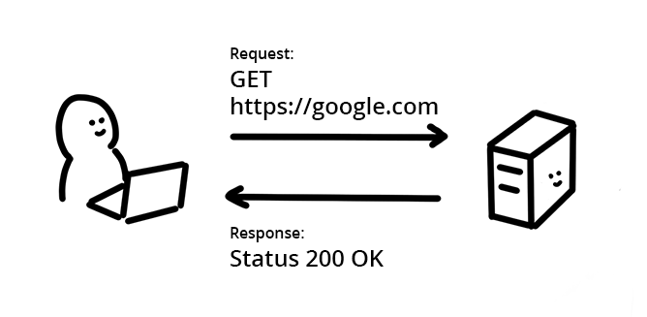
FIREBASE Setup

